Slide 1

Computer Organization & Architecture
ECE 2002
Dr. S Saritha
Assistant Professor
SENSE

Slide 2
Module 1: Computer evolution and arithmetic
A Brief History of computers
Basic structures of Computers: Computer Architecture vs. Computer Organization
Functional units and Operational concepts
RISC Vs CISC
Registers
Performance assessment, MIPS
Bus and Bus organization
Memory location and addresses
Fixed and Floating point numbers, Signed numbers, Integer Arithmetic

Slide 3
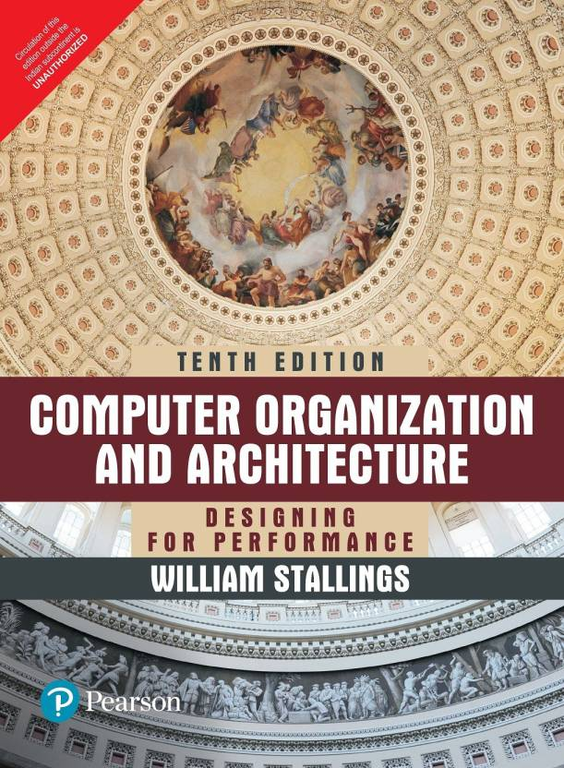
Text Book: William Stallings, Computer Organization and Architecture: Designing for Performance, Pearson Education, Tenth Edition,2013
Books:
1. M. Morris Mano, Rajib Mall, Computer System Architecture, Pearson Education Third Edition,2017.
2. Carl Hamacher, Zvonkovranesic, Safwat Zaky , Computer Organization, McGraw Hill, Fifth Edition,2011.

Slide 4
Computer
CPU
Performs arithmetic and logical operations
INPUT-OUTPUT devices (PERIPHERALS)
Keyboards, monitor, modem, mouse, joystick, speaker, printer, etc
MEMORY
Primary-Directly accessible by the CPU
Secondary-external memory for storing

Slide 5
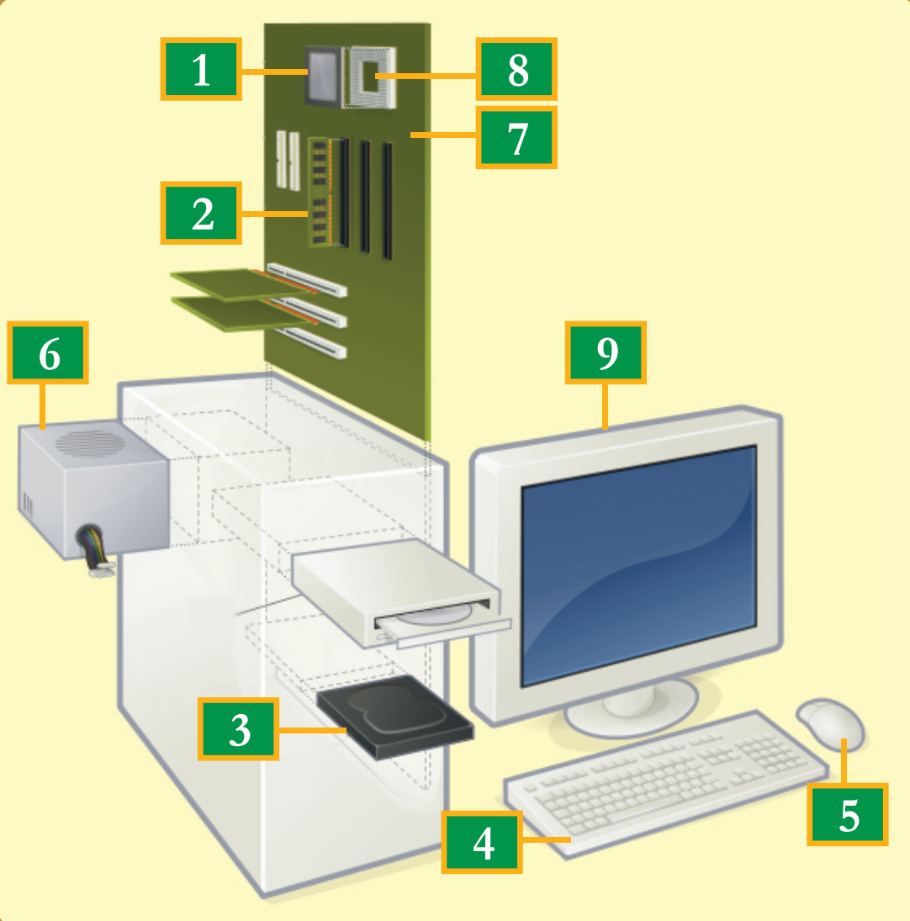
A typical Computer
1. Processor
2. RAM/Main memory
3. Hard disk
4. Keyboard
5. Mouse
6. Power supply
7. Motherboard
8. BIOS system
9. Monitor

Slide 6
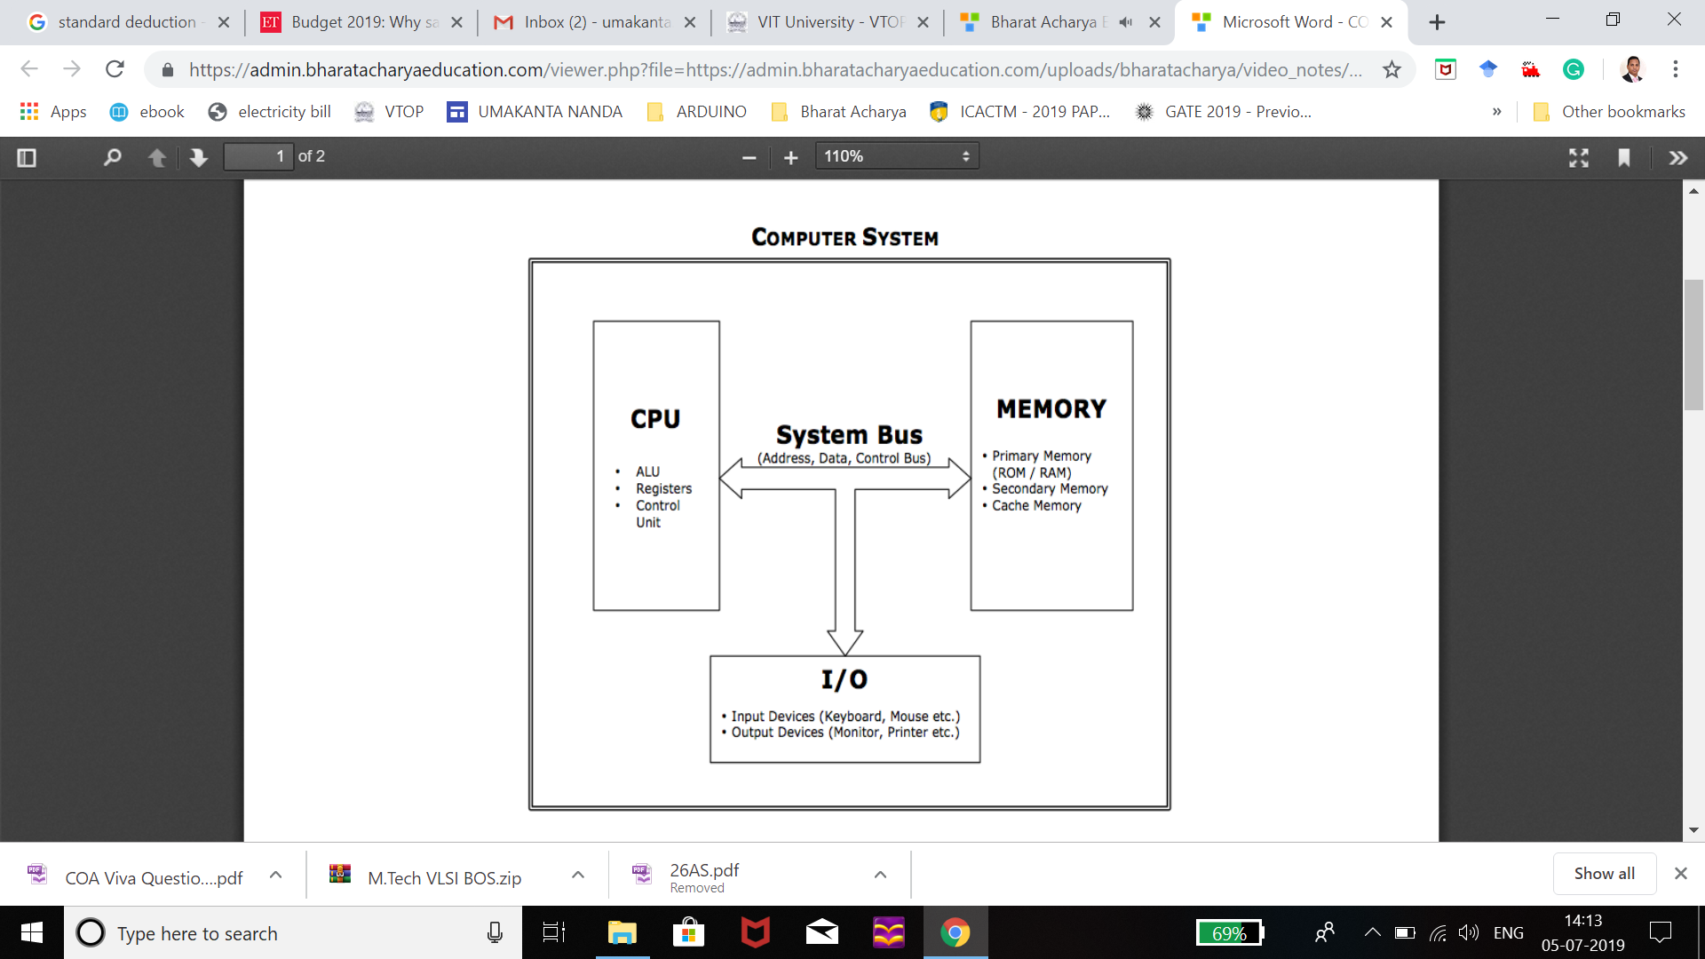

Slide 7
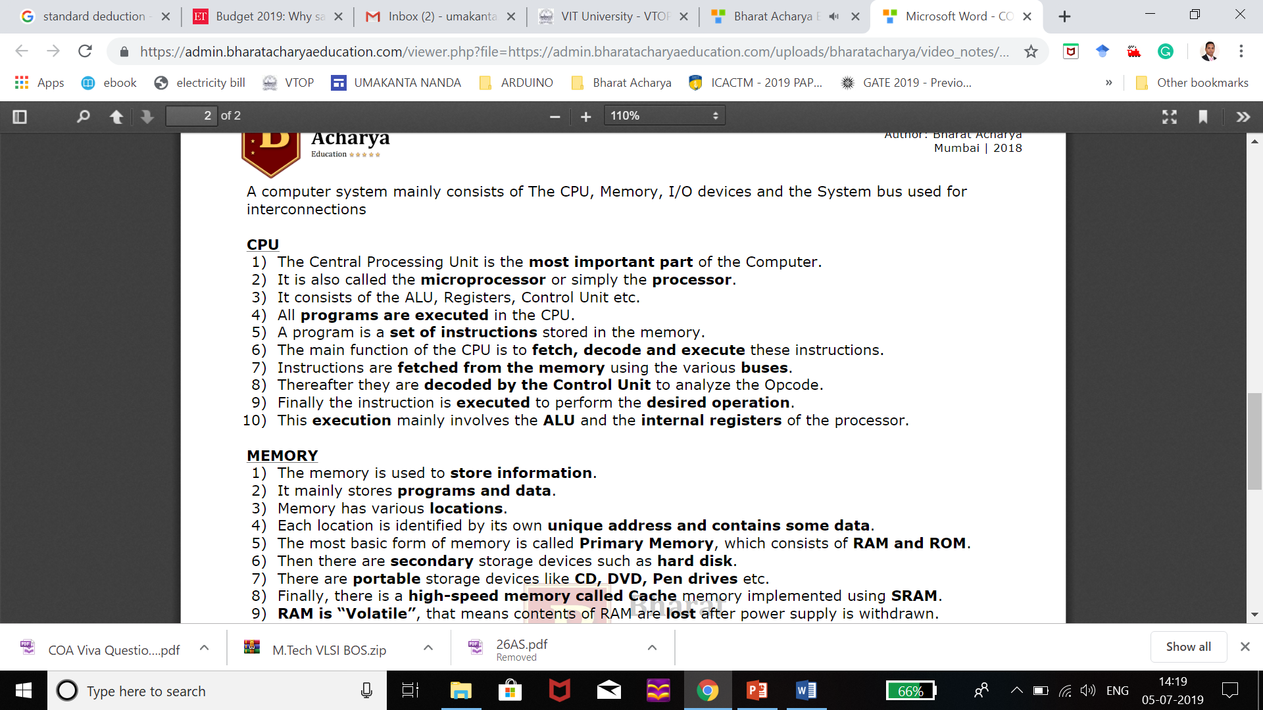

Slide 8
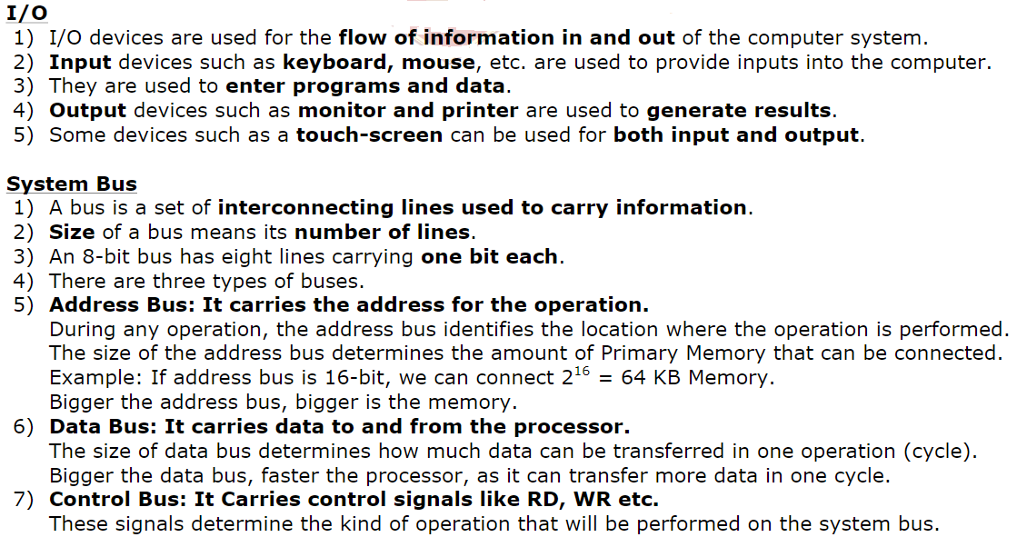
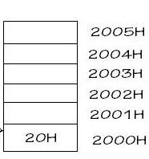

Slide 9
Architecture & Organization
Architecture is those attributes visible to the programmer
Instruction set, number of bits used for data representation, I/O mechanisms, addressing techniques.
e.g. Is there a multiply instruction?
Computer Architecture is also referred as Instruction set architecture (ISA) which has an algorithm to control various components.
Organization is how features are implemented by interconnecting the operational units to realize the specific architectural specifications.
Control signals, interfaces, memory technology.
e.g. Is there a hardware multiply unit or is it done by repeated addition?
ISA
Instruction format
Instruction opcode
Register
Instruction and Data memory
Notes:
All Intel x86 family share the same basic architecture
The IBM System/370 family share the same basic architecture
This gives code compatibility
Organization differs between different versions
Ex: Pipelining

Slide 10
 | Computer Architecture | Computer Organization
1. | Architecture describes what the computer does. | The Organization describes how it does it.
2. | Computer Architecture deals with the functional behavior of computer systems. | Computer Organization deals with a structural relationship.
3. | In the above figure, it’s clear that it deals with high-level design issues. | In the above figure, it’s also clear that it deals with low-level design issues.
4. | Architecture indicates its hardware. | Whereas Organization indicates its performance.
5. | As a programmer, you can view architecture as a series of instructions, addressing modes, and registers. | The implementation of the architecture is called organization.
6. | For designing a computer, its architecture is fixed first. | For designing a computer, an organization is decided after its architecture.
7. | Computer Architecture is also called Instruction Set Architecture (ISA). | Computer Organization is frequently called microarchitecture.
8. | Computer Architecture comprises logical functions such as instruction sets, registers, data types, and addressing modes. | Computer Organization consists of physical units like circuit designs, peripherals, and adders.

Slide 11
Structure & Function
Structure is the way in which components relate to each other
Function is the operation of individual components as part of the structure
Function
Data processing
Data storage
Data movement
Control
Structure
CPU
Main memory
I/O
System interconnection

Slide 12
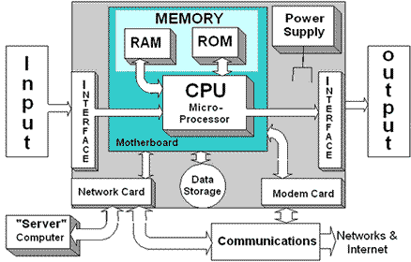
Computer Diagram

Slide 13
History of computers
First Generation: Vacuum Tubes
Second Generation: Transistors
Third Generation: Integrated circuits
Later generations: LSI and VLSI

Slide 14
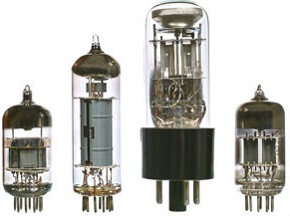
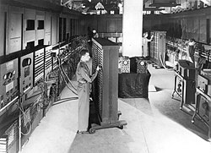
First Gen: Vacuum tubes
ENIAC (Electronic Numerical Integrator and Computer)
Built in 1943 for WW-II
Weighed 30 tons, occupying 1500 square feet of floor space, and containing more than 18,000 vacuum tubes
Consumed 140 kilowatts of power
Faster than any electromechanical computer, capable of 5000 additions per second

Slide 15
ENIAC
It was a decimal computer, rather than a binary one
Its memory consisted of 20 “accumulators,” each capable of holding a 10-digit decimal number
A ring of 10 vacuum tubes represented each digit
The major drawback is that it had to be programmed manually by setting switches and plugging and unplugging cables

Slide 16
Von Neumann machine
Program could be represented in a form suitable for storing in memory alongside the data
A computer could get its instructions by reading them from memory
This program could be set or altered by setting the values of a portion of memory
This idea, known as the stored-program concept, usually attributed to the mathematician John von Neumann
Shortly, the design of a new stored program computer, referred to as the IAS computer, at the Princeton Institute for Advanced Studies
Took 6 Years to build and is the prototype for all the subsequent general-purpose computers

Slide 17
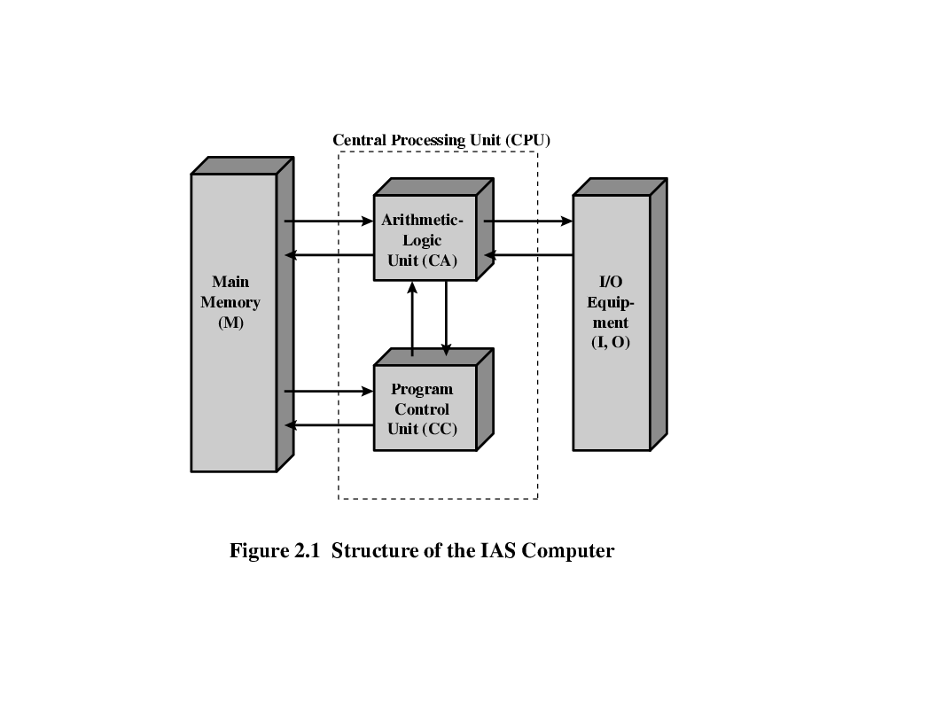
Von Neumann/Turing
Stored program concept (memory comes to picture)
Main memory storing programs and data
ALU operating on binary data
Control unit interpreting instructions from memory and executing
Input and output equipment operated by control unit
Princeton institute for advanced studies (IAS)
Completed 1952
CA: Central Arithmetic
CC: Central Control
Structure of von Neumann machine

Slide 18
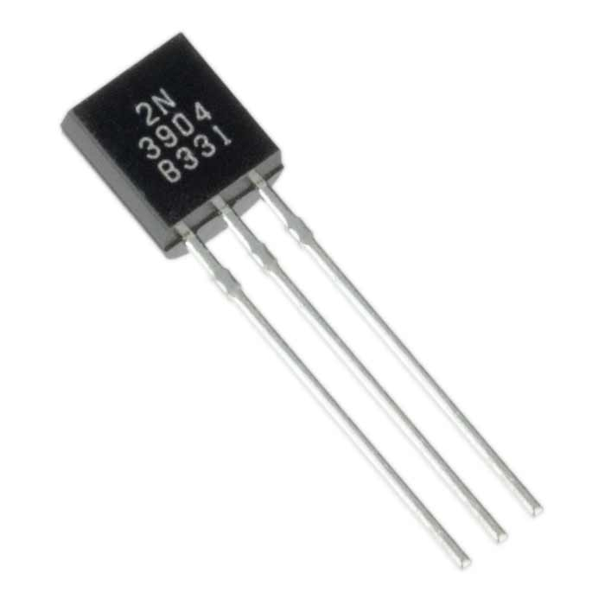
Second GEN: Transistors
Invented at Bell Labs in 1947; by 1950s → electronic revolution.
Late 1950s → fully transistorized computers were commercially available
Smaller, cheaper, and dissipates less heat; can be used in the same way as a vacuum tube to construct computers
The second generation introduced more complex ALUs and CUs
Use of high-level programming languages, and system software with the computer.

Slide 19
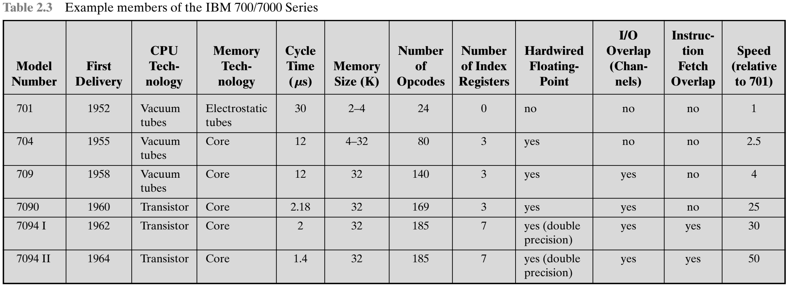

Slide 20
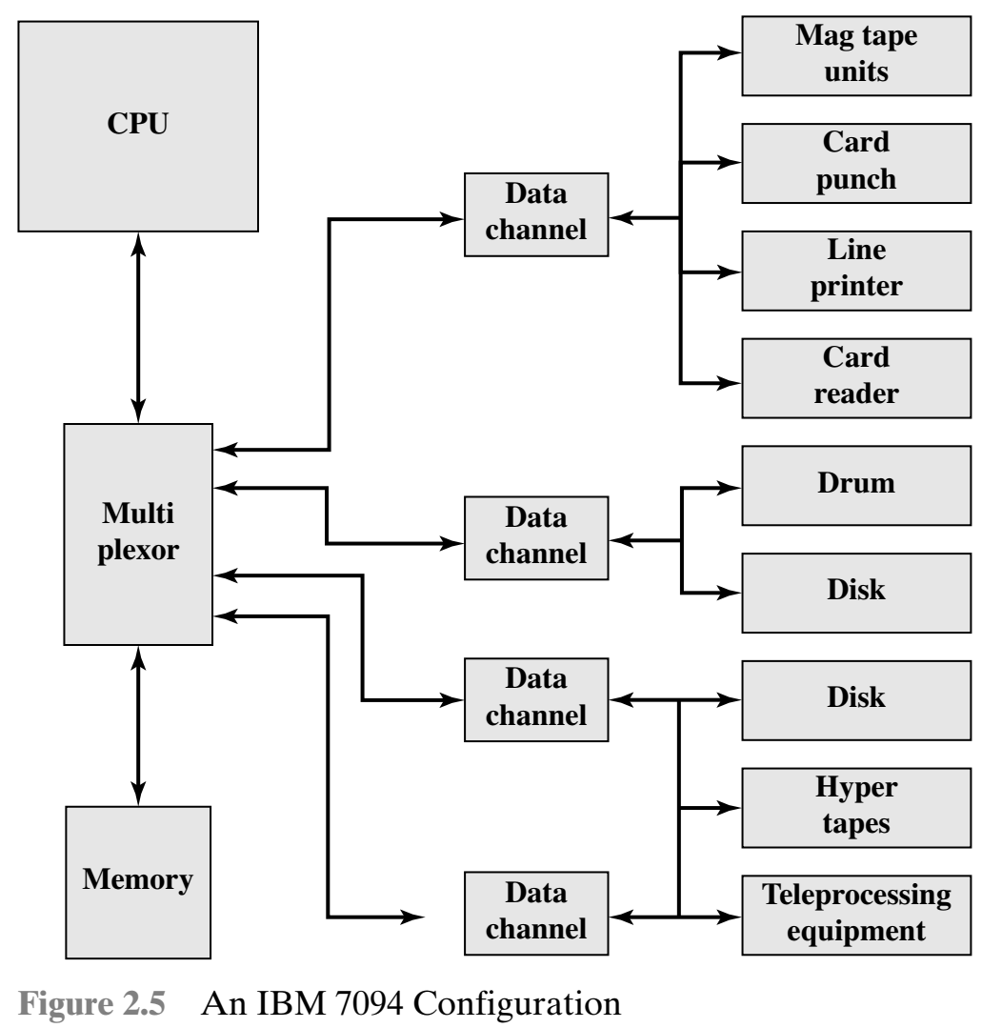

Slide 21
Third gen: Integrated circuits
A single, self-contained transistor is called a discrete component
1950s to early 1960s, electronic equipment was composed largely of discrete components—transistors, resistors, capacitors, and so on.
Discrete components were manufactured separately → packaged in their own containers → soldered or wired together onto circuit boards → then installed in computers, oscilloscopes, and other electronic equipment.
Whenever an electronic device needed a transistor replacement, a small piece of silicon had to be soldered to a circuit board; made the manufacturing process expensive and cumbersome.
The Early second-generation computers contained about 10,000 transistors. This figure grew to the hundreds of thousands; manufacturing of newer, more powerful machines became increasingly difficult.

Slide 22
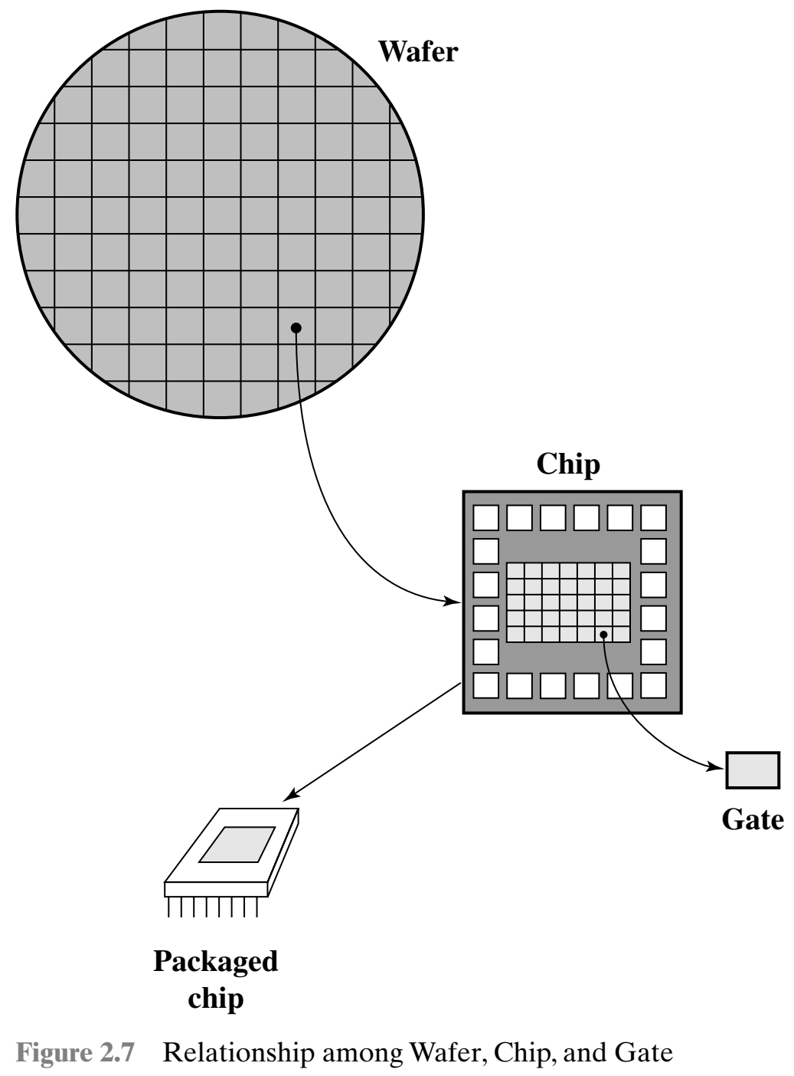
Third gen: Integrated circuits
1958 → invention of the Integrated circuit
The integrated circuit exploits the fact that → components as transistors, resistors, and conductors can be fabricated from a semiconductor such as silicon.
Fabrication of an entire circuit in a tiny piece of silicon; rather than assemble discrete components using separate pieces of silicon
Many transistors can be produced at the same time on a single wafer of silicon; and can be connected with a process of metallization to form circuits

Slide 23
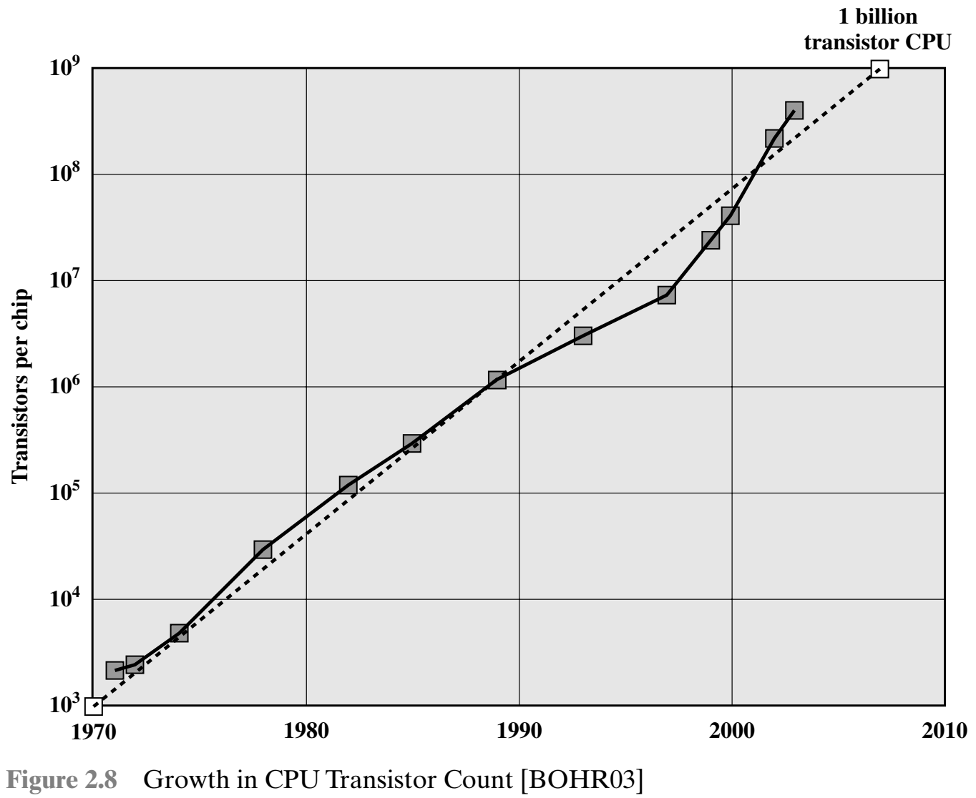
Integrated circuits
Initially, only a few gates or memory cells could be reliably manufactured and packaged together; known as SSI
As time went on, it became possible to pack more and more components on the same chip.
This figure reflects the famous Moore’s law, which was propounded by Gordon Moore, cofounder of Intel, in 1965.

Slide 24
Integrated circuits
Moore observed that the #Transistors was doubling every year; correctly predicted that this pace would continue
The pace continued year after year and decade after decade; it slowed to a doubling every 18 months in the 1970s but has sustained that rate ever since
Consequences of Moore’s law:
The cost of a chip has remained virtually unchanged during this period of rapid growth in density. This means that the cost of computer logic and memory circuitry has fallen at a dramatic rate.
Because logic and memory elements are placed closer together on more densely packed chips, the electrical path length is shortened, increasing operating speed.
The computer becomes smaller, making it more convenient to place in a variety of environments.
There is a reduction in power and cooling requirements.
The interconnections on the integrated circuit are much more reliable than solder connections. With more circuitry on each chip, there are fewer interchip connections

Slide 25
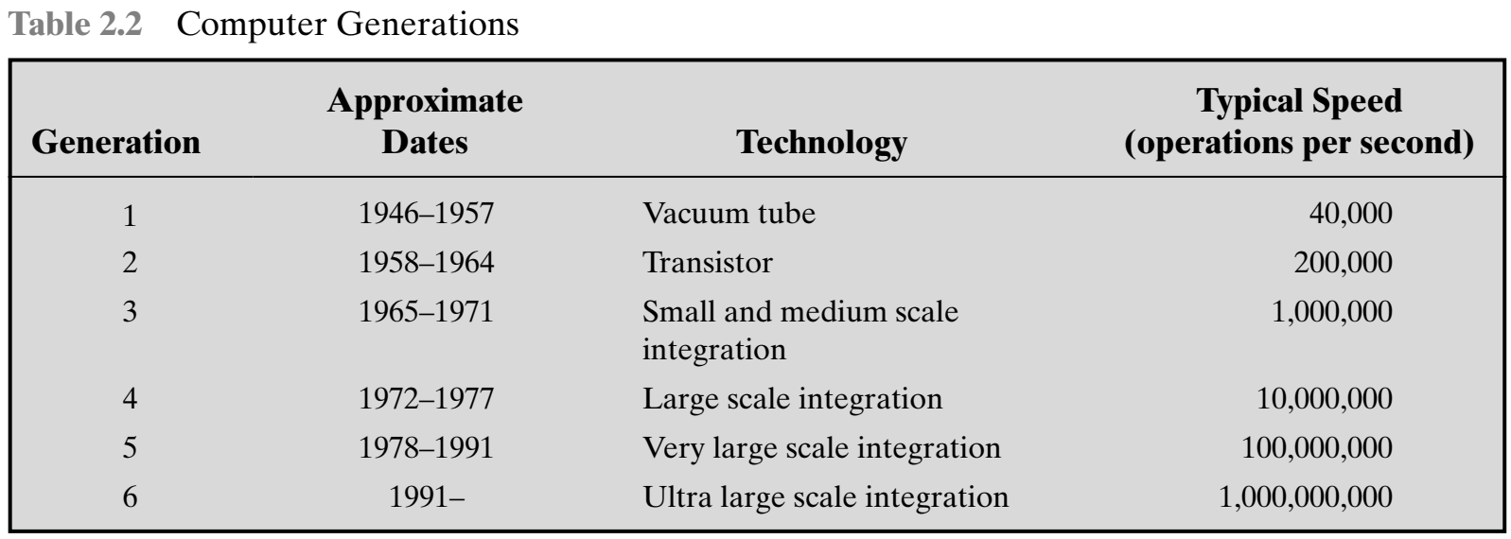
Later generations

Slide 26
Later generations
With the introduction of largescale integration (LSI), more than 1000 components can be placed on a single integrated circuit chip.
Very-large-scale integration (VLSI) achieved more than 10,000 components per chip, while current ultra-large-scale integration (ULSI) chips can contain more than one million components.
The first application of integrated circuit technology to computers was construction of the processor
It was also found that this same technology could be used to construct memories

Slide 27
Later generations
In the 1950s and 1960s, most computer memory was constructed from tiny rings of ferromagnetic materials
Magnetized one way, a ring (called a core) represented a one; magnetized the other way, it stood for a zero.
Magnetic-core memory was rather fast; it took as little as a millionth of a second to read a bit stored in memory.
But it was expensive, bulky, and used destructive readout: The simple act of reading a core erased the data stored in it.
It was therefore necessary to install circuits to restore the data as soon as it had been extracted.

Slide 28
Later generations
Then, in 1970, Fairchild produced the first semiconductor memory.
This chip, about the size of a single core, could hold 256 bits of memory.
It was nondestructive and much faster than core. It took only 70 billionths of a second to read a bit.
However, the cost per bit was higher than for that of core
In 1974, the price per bit of semiconductor memory dropped below the price per bit of core memory.
Following this, there has been a continuing and rapid decline in memory cost accompanied by a corresponding increase in physical memory density.
This has led the way to smaller, faster machines with memory sizes of larger and more expensive machines from just a few years earlier.
Developments in memory technology, together with developments in processor technology changed the nature of computers in less than a decade.

Slide 29
Microprocessors
A breakthrough was achieved in 1971, when Intel developed its 4004.
The 4004 was the first chip to contain all of the components of a CPU on a single chip: The microprocessor was born.
The 4004 can add two 4-bit numbers and can multiply only by repeated addition.
By today’s standards, the 4004 is hopelessly primitive, but it marked the beginning of a continuing evolution of microprocessor capability and power.
The next major step in the evolution of the microprocessor was the introduction in 1972 of the Intel 8008.
This was the first 8-bit microprocessor and was almost twice as complex as the 4004.

Slide 30
Microprocessors
The introduction, in 1974, of the Intel 8080.
This was the first general-purpose microprocessor.
The 4004 and the 8008 had been designed for specific applications, the 8080 was designed to be the CPU of a general-purpose microcomputer.
Like the 8008, the 8080 is an 8-bit microprocessor.
It was faster, has a richer instruction set, and has a large addressing capability.

Slide 31
Microprocessors
About the same time, 16-bit microprocessors began to be developed.
However, it was not until the end of the 1970s that powerful, general-purpose 16-bit microprocessors appeared. One of these was the 8086.
The next step in this trend occurred in 1981, when both Bell Labs and Hewlett-Packard developed 32-bit, single-chip microprocessors.
Intel introduced its own 32-bit microprocessor, the 80386, in 1985

Slide 32
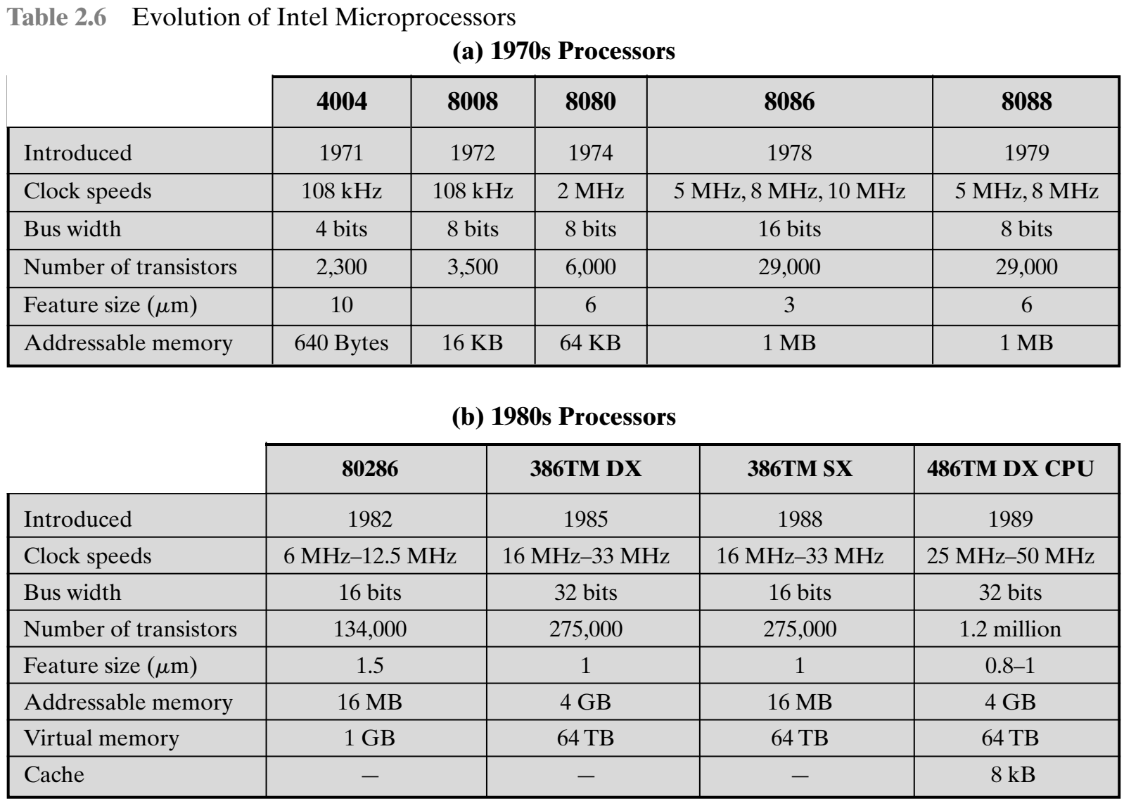

Slide 33
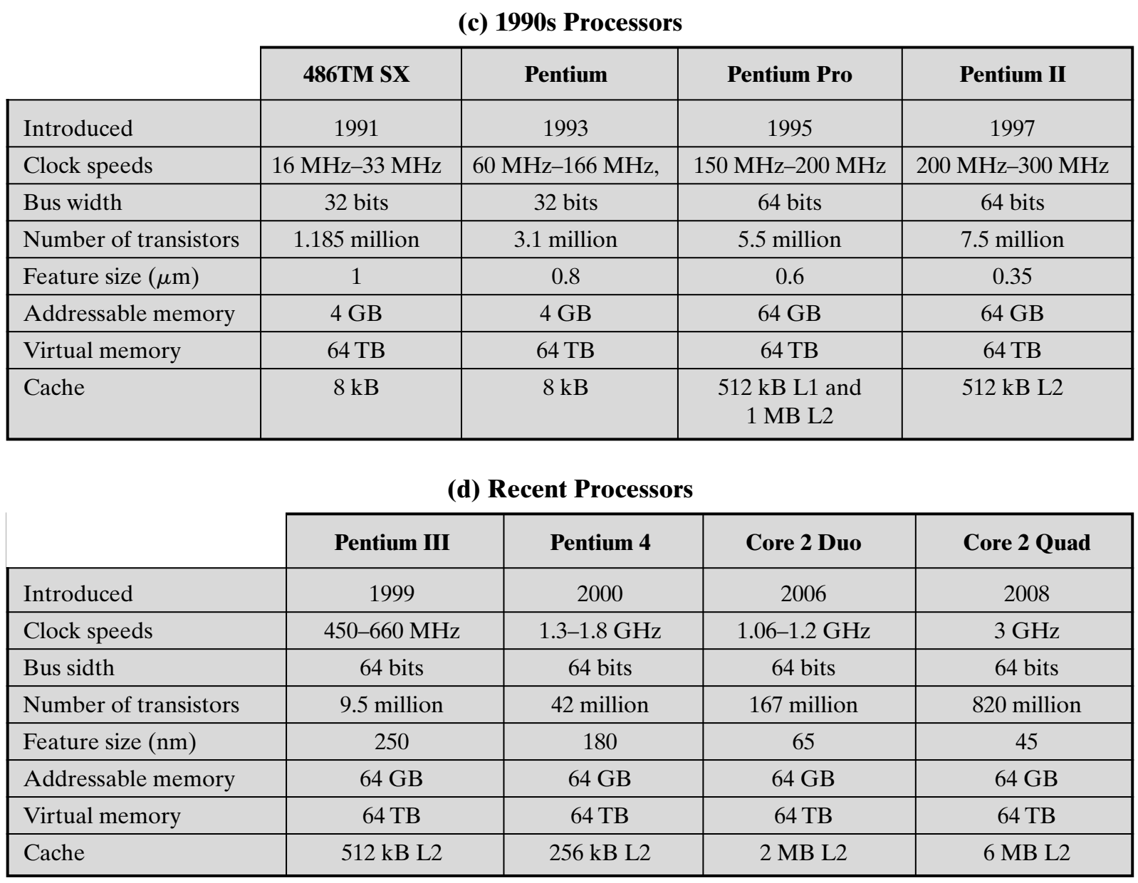

Slide 34
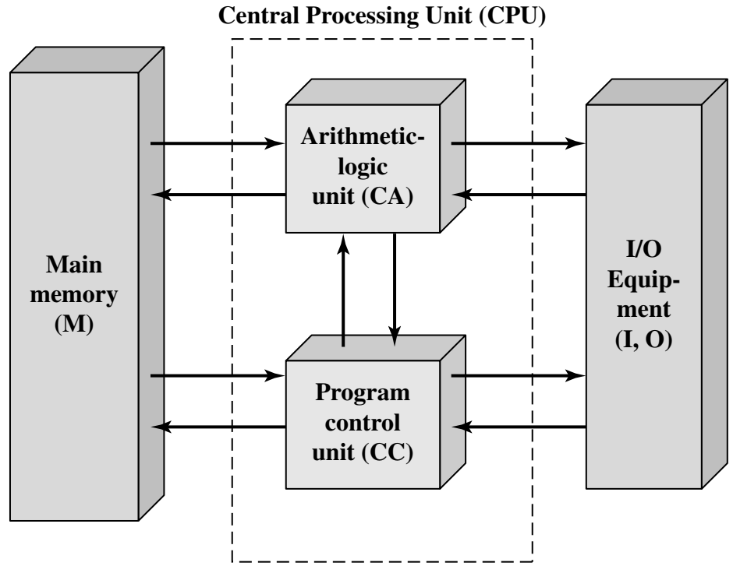
IAS Computer
A main memory, which stores both data and instructions
An arithmetic and logic unit (ALU) capable of operating on binary data
A control unit, which interprets the instructions in memory and causes them to be executed
Input and output (I/O) equipment operated by the control unit

Slide 35
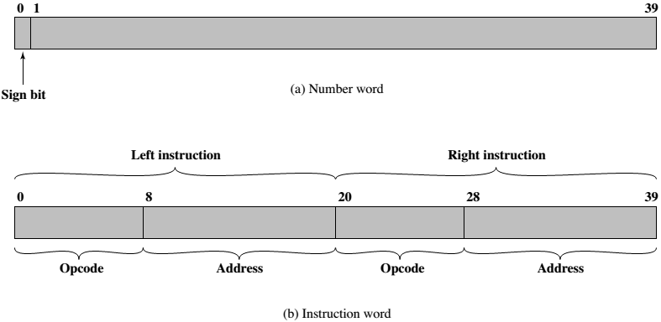
EXAMPLE

Slide 36
Working of IAS
The memory of the IAS consists of 1000 storage locations, called words, of 40 binary digits (bits) each.
Both data and instructions are stored there.
Numbers are represented in binary form, and each instruction is a binary code.
Each number is represented by a sign bit and a 39-bit value.
A word may also contain two 20-bit instructions, with each instruction consisting of an 8-bit operation code (opcode) specifying the operation to be performed and a 12-bit address designating one of the words in memory (numbered from 0 to 999).

Slide 37
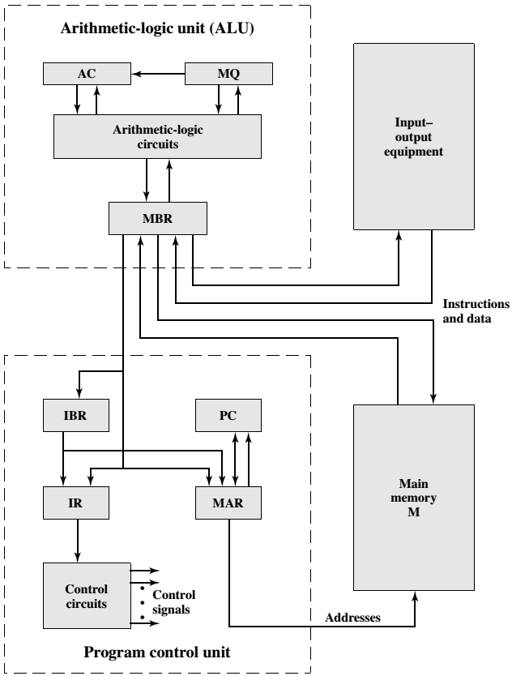

Slide 38
Registers in IAS
Memory buffer register (MBR): Contains a word to be stored in memory or sent to the I/O unit, or is used to receive a word from memory or from the I/O unit.
Memory address register (MAR): Specifies the address in memory of the word to be written from or read into the MBR.
Instruction register (IR): Contains the 8-bit opcode instruction being executed.
Instruction buffer register (IBR): Employed to hold temporarily the righthand instruction from a word in memory.
Program counter (PC): Contains the address of the next instruction-pair to be fetched from memory.
Accumulator (AC) and multiplier quotient (MQ): Employed to hold temporarily operands and results of ALU operations.

Slide 39
Registers in IAS
Memory buffer register (MBR): Contains a word to be stored in memory or sent to the I/O unit, or is used to receive a word from memory or from the I/O unit.
Memory address register (MAR): Specifies the address in memory of the word to be written from or read into the MBR.
Instruction register (IR): Contains the 8-bit opcode instruction being executed.
Instruction buffer register (IBR): Employed to hold temporarily the righthand instruction from a word in memory.
Program counter (PC): Contains the address of the next instruction-pair to be fetched from memory.
Accumulator (AC) and multiplier quotient (MQ): Employed to hold temporarily operands and results of ALU operations.

Slide 40
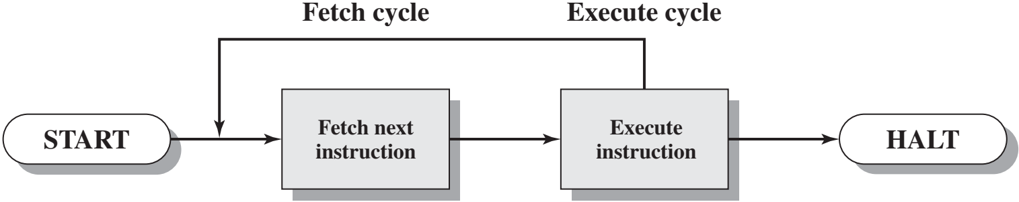
Computer function
Basic function performed by the computer is execution of the program → set of instructions stored in memory
Instruction processing consists of two steps
Processor reads / Fetches
Executing the fetched instruction
Processing required for a single instruction is known as instruction cycle

Slide 41
Instruction fetch and execute
At the beginning of each instruction cycle, the processor fetches an instruction from memory
A register called the program counter (PC) holds the address of the instruction to be fetched next
Unless told otherwise, the processor always increments the PC after each instruction fetch so that it will fetch the next instruction in sequence i.e. the instruction located in the next higher memory address
The fetched instruction is loaded into a register in the processor known as the instruction register (IR)
The instruction contains bits that specify the action the processor needs to take
The processor interprets the instruction and performs the required action

Slide 42
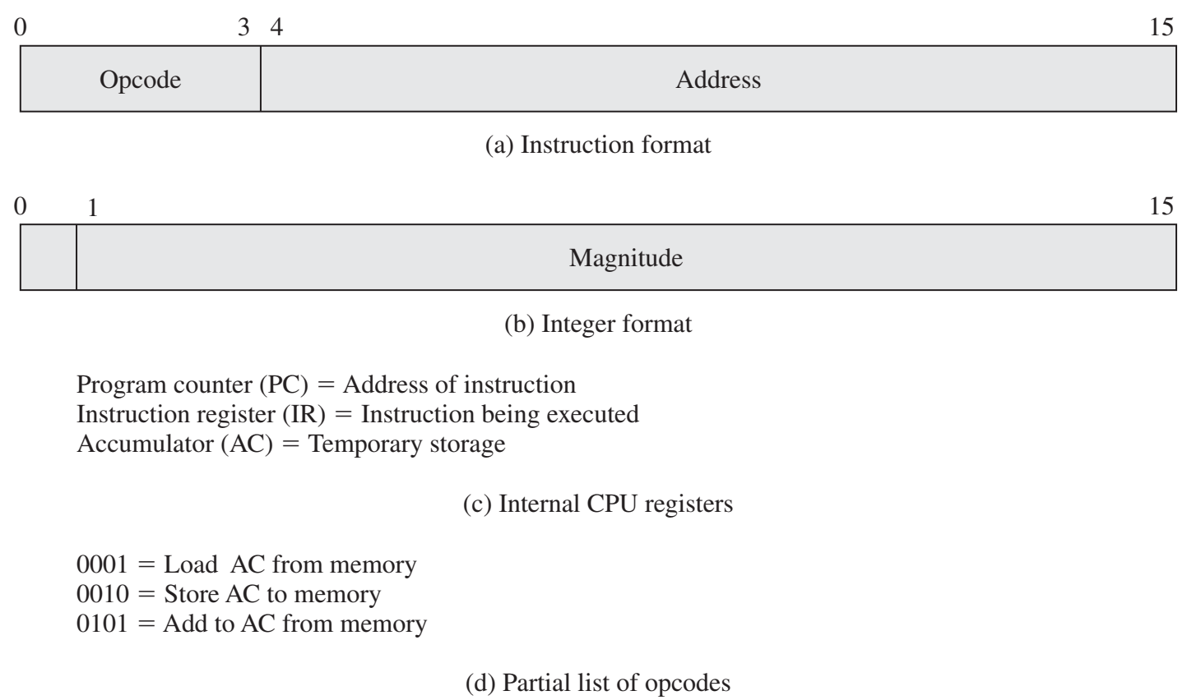
Example
Suppose a processor contains a single data register, called an accumulator (AC)
Both instructions and data are 16 bits long
The instruction format provides 4 bits for the opcode → 16 opcodes and 4096 (4K) memory

Slide 43

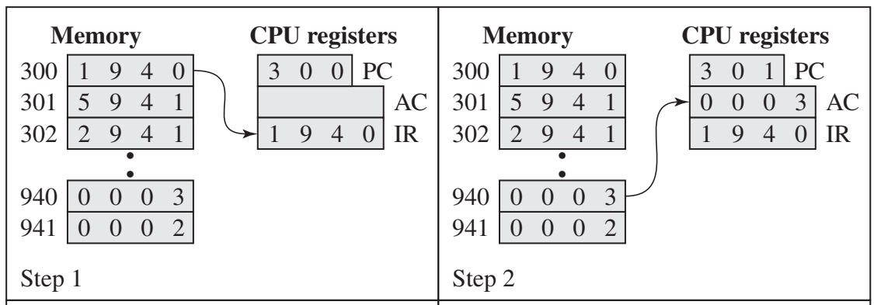

Slide 45
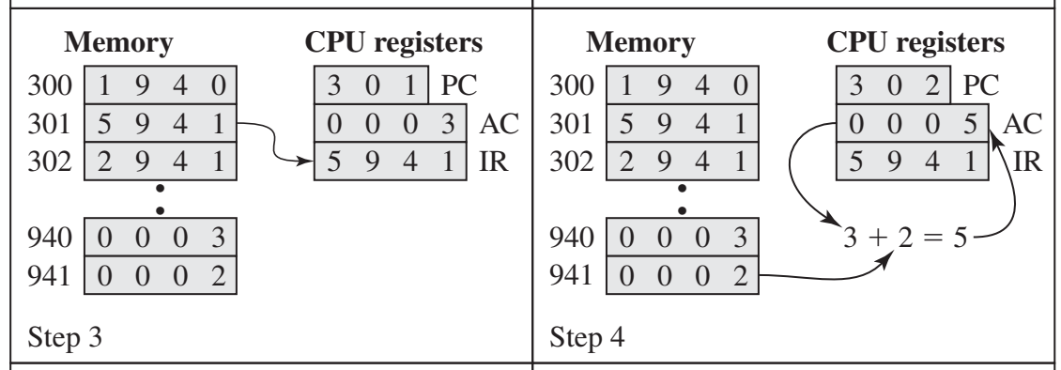

Slide 47
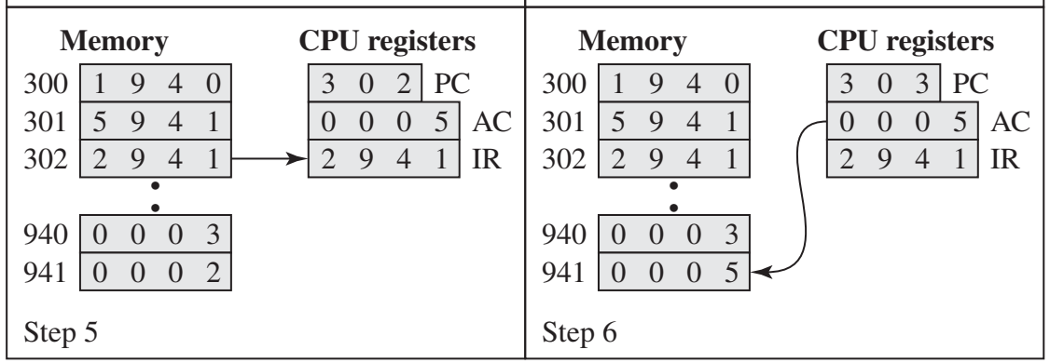

Slide 49
Example
In this example, three instruction cycles, each consisting of a fetch cycle and an execute cycle, are needed to add the contents of location 940 to the contents of 941.
With a more complex set of instructions, fewer cycles would be needed.
Some older processors, for example, included instructions that contain more than one memory address.
For example, the PDP-11 processor expressed symbolically as ADD B,A
Fetch the ADD instruction.
Read the contents of memory location A into the processor.
Read the contents of memory location B into the processor. In order that the contents of A are not lost, the processor must have at least two registers for storing memory values, rather than a single accumulator.
Add the two values.
Write the result from the processor to memory location A.

Slide 50
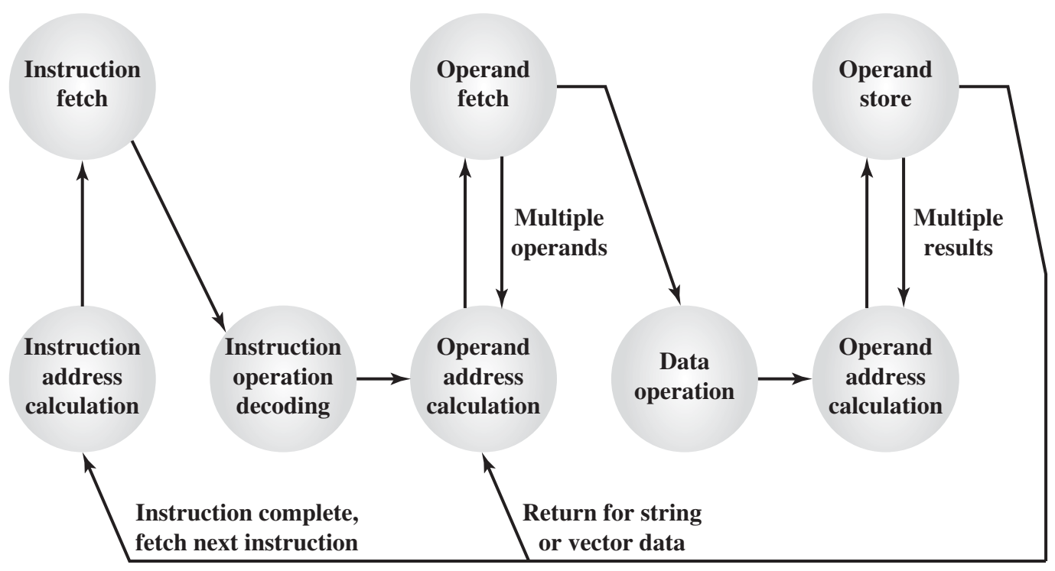

Slide 51
States
Instruction address calculation (IAC): Determine the address of the next instruction to be executed.
Instruction fetch (if): Read instruction from its memory location into the processor.
Instruction operation decoding (iod): Analyze instruction to determine type of operation to be performed and operand(s) to be used.
Operand address calculation (oac): If the operation involves reference to an operand in memory or available via I/O, then determine the address of the operand.
Operand fetch (of): Fetch the operand from memory or read it in from I/O.
Data operation (do): Perform the operation indicated in the instruction.
Operand store (os): Write the result into memory or out to I/O.

Slide 52
States
The oac state appears twice, because an instruction may involve a read, a write, or both.
Example → ADD A,B results in the following sequence of states: iac, if, iod, oac, of, oac, of, do, oac, os.
A single instruction can specify an operation to be performed on an array of numbers or a string of characters → involves repetitive operand fetch and store operations

Slide 53
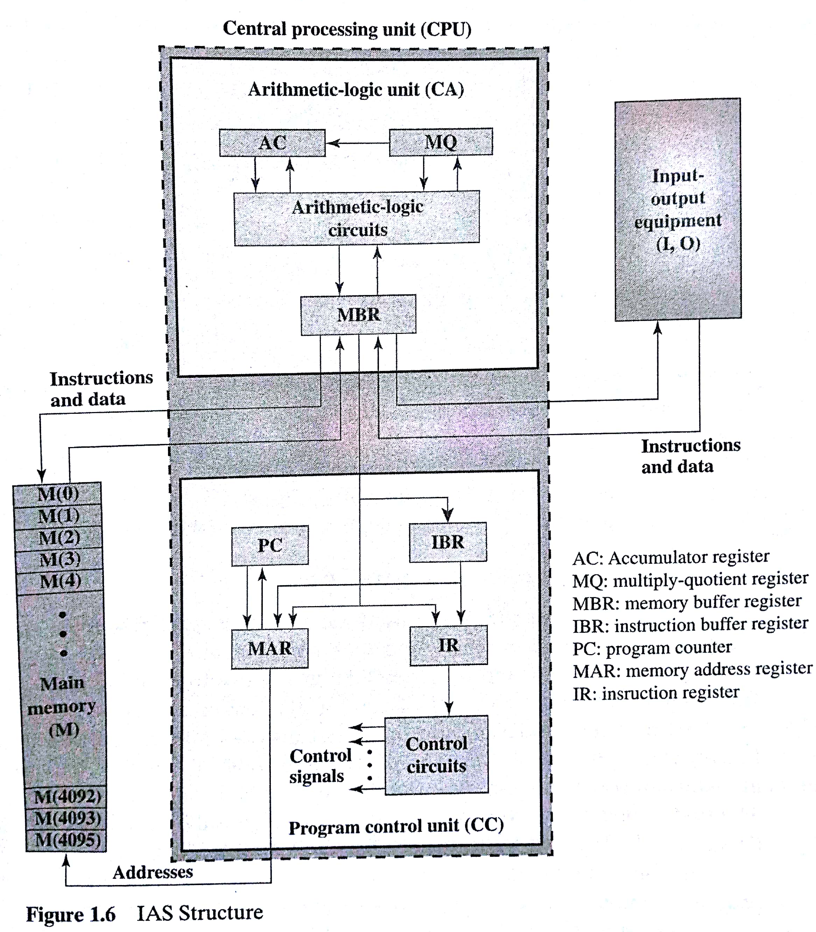
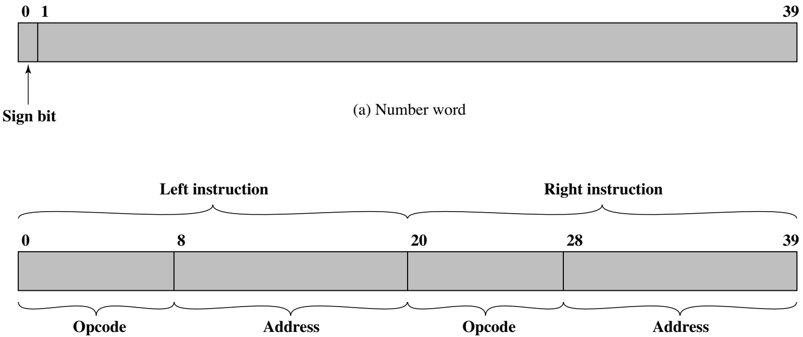
IAS structure

Slide 54
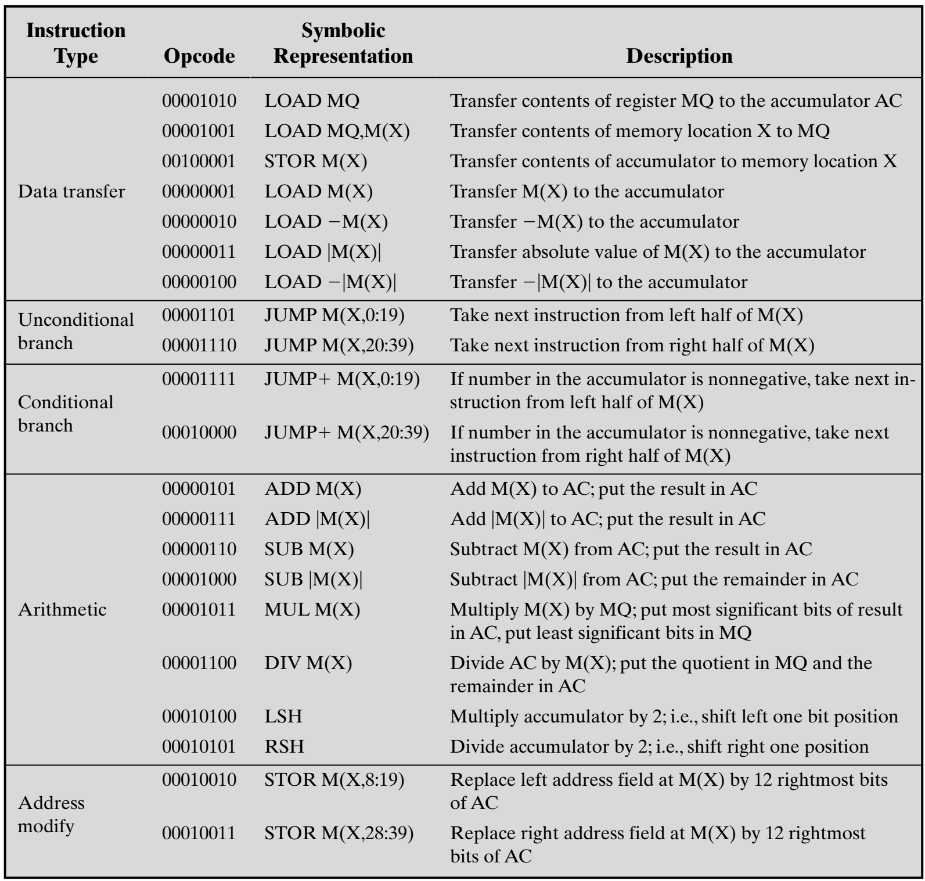

Slide 55
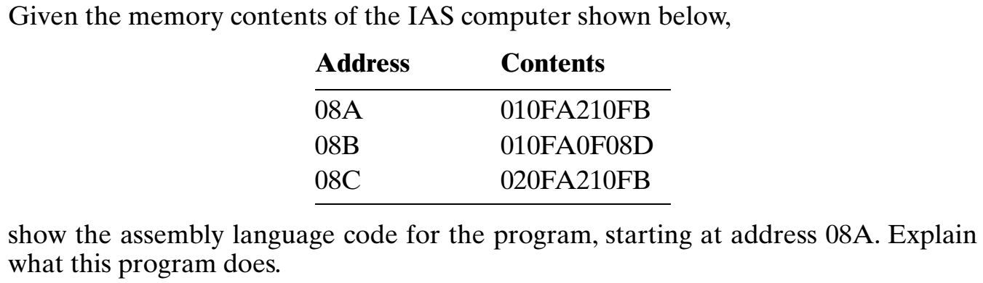
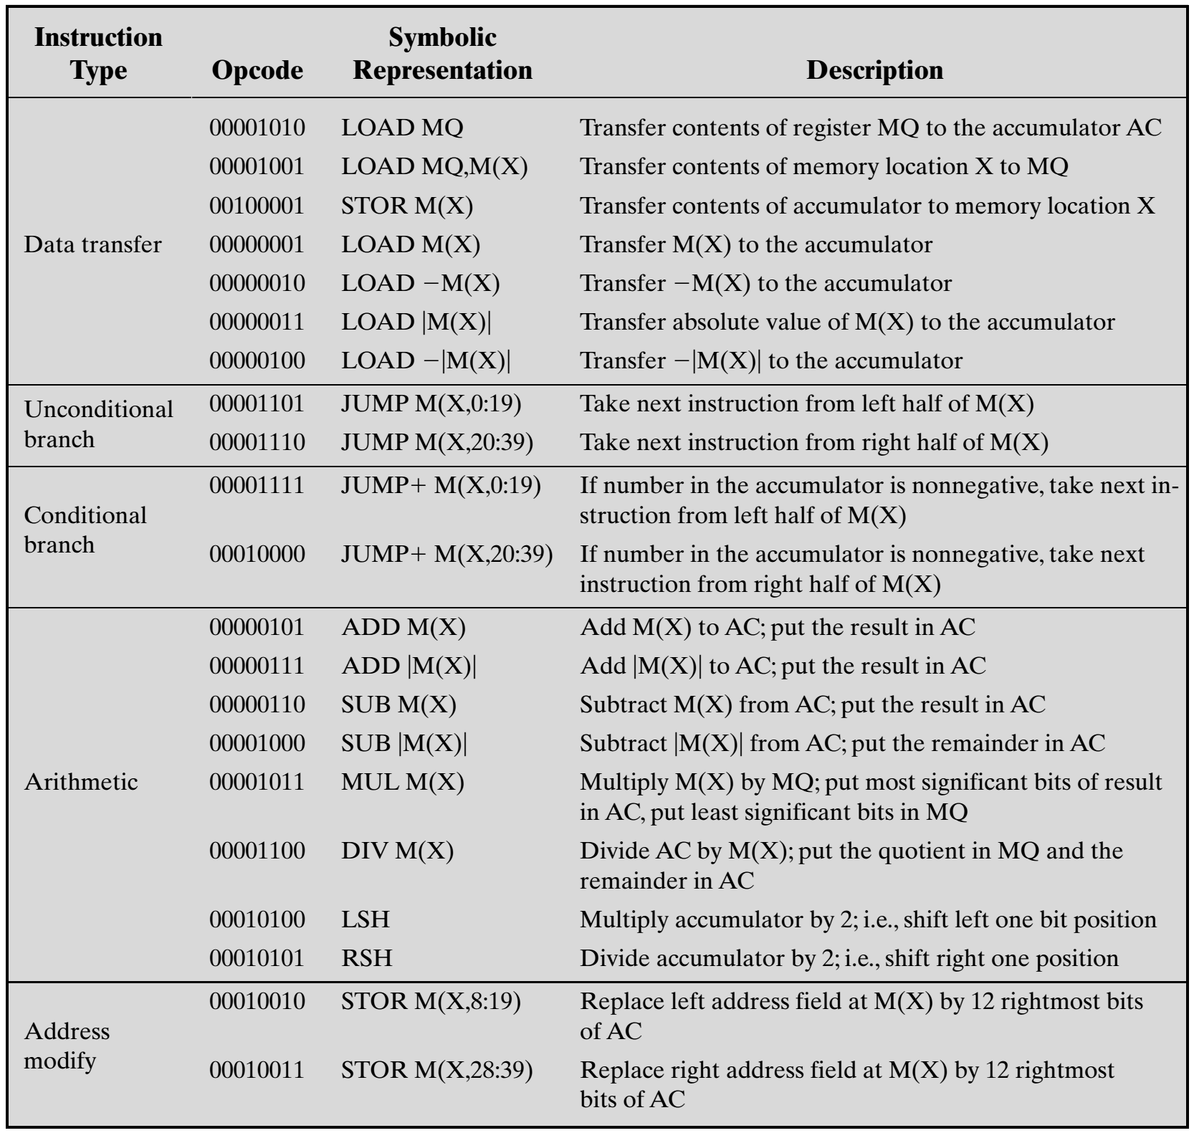
P1

Slide 56
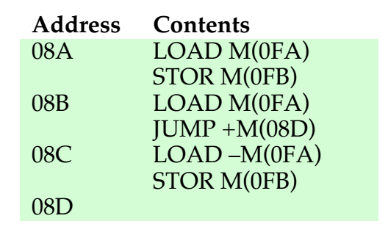
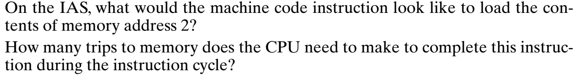
P1
This program will store the absolute value of content at memory location 0FA into memory location 0FB.
P2

Slide 57
P2
OPCODE | OPERAND
00000001 | 000000000010
First, the CPU must make access memory to fetch the instruction. The instruction contains the address of the data we want to load. During the execute phase accesses memory to load the data value located at that address for a total of two trips to memory.

Slide 58
Problem
Write a program to add 5 numbers located at consecutive memory locations starting at address 500. Add another 5 numbers located at consecutive memory locations starting at address 600. Subtract the lower value from the higher value and store it at location having address 700.
800: LOAD M(500) [Left Instr] 803: ADD M(601) [Right Instr] 807: LOAD -M(702) [Left Instr]
800: ADD M(501) [Right Instr] 804: ADD M(602) [Left Instr] 807: STOR M(700) [Right Instr]
801: ADD M(502) [Left Instr] 804: ADD M(603) [Right Instr]
801: ADD M(503) [Right Instr] 805: ADD M(604) [Left Instr]
802: ADD M(504) [Left Instr] 805: SUB M(701) [Right Instr]
802: STOR M(701) [Right Instr] 806: JUMP+ M(807,20:39) [Left Instr]
803: LOAD M(600) [Left Instr] 806: STOR M(702) [Right Instr]
Sol:

Slide 63
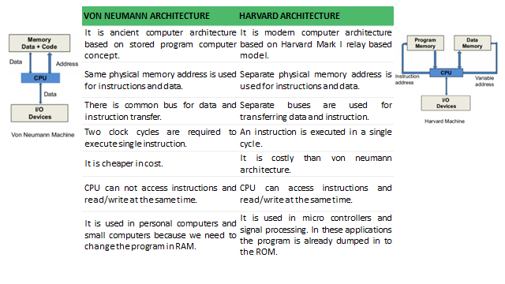

Slide 64
CISC and RISC refer to design principles and techniques, T=(N*S)/R
RISC
CISC
1. RISC: Reduced instruction set computers.
2. Simple instructions require a small number of basic steps to execute.
3. For a processor that has only simple instructions, a large number of instructions may by need to perform a given programming task. This could lead to a large value of N and a small value for S.
4. It is much easier to implement efficient pipelining in processors with simple instruction sets.
1. CISC: Complex instruction set computers.
2. Complex instructions involve a large number of steps.
3. If individual instructions perform more complex operations, fewer instructions will be needed, leading to a lower value of N and a larger value of S.
4. Complex instructions combined with pipelining would achieve good performance

Slide 65
Performance Assessment
Performance is one of the key parameters to consider, along with cost, size, security, reliability, and, in some cases power consumption.
Application performance depends not just on the raw speed of the processor, but on the instruction set, choice of implementation language, efficiency of the compiler, and skill of the programming.
Clock Speed
The System Clock: The most fundamental level, the speed of a processor is dictated by the pulse frequency produced by the clock, measured in cycles per second, or Hertz (Hz).
Clock signals are generated by a quartz crystal
The rate of pulses is known as the clock rate, or clock speed
One increment, or pulse, of the clock is referred to as a clock cycle, or a clock tick.
The time between pulses is the cycle time.
For example, a 1-GHz processor receives 1 billion pulses per second.

Slide 66
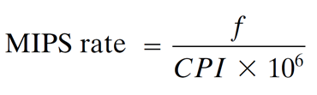
Performance Assessment
Millions of instructions per second (MIPS) or MIPS rate
The System Clock: The most fundamental level, the speed of a processor is dictated by the pulse frequency produced by the clock, measured in cycles per second, or Hertz (Hz).
CPI: Cycle per instruction
f: Clock frequency (number of cycle per second)
Example: Consider a program having 500 million instructions, running on a 400 MHz processor. The program consists of three major types of instructions - ALU related, load/store, and branching. These instructions require 1, 2, and 4 CPI with a instruction mix of 60, 30, and 10% respectively in the program. Estimate the MIPS of the processor.
Solution: CPI=0.6x1+0.3x2+0.1x4=1.6
MIPS=(400x10⁶)/(1.6x10⁶)=250 MIPS
Similarly there are other performance parameters.

Slide 67
Performance Assessment
Millions of instructions per second (MIPS) or MIPS rate
The System Clock: The most fundamental level, the speed of a processor is dictated by the pulse frequency produced by the clock, measured in cycles per second, or Hertz (Hz).
CPI: Cycle per instruction
f: Clock frequency (number of cycle per second)
Example: Consider a program having 500 million instructions, running on a 400 MHz processor. The program consists of three major types of instructions - ALU related, load/store, and branching. These instructions require 1, 2, and 4 CPI with a instruction mix of 60, 30, and 10% respectively in the program. Estimate the MIPS of the processor.
Solution: CPI=0.6x1+0.3x2+0.1x4=1.6
MIPS=(400x10⁶)/(1.6x10⁶)=250 MIPS
Similarly there are other performance parameters.

Slide 71
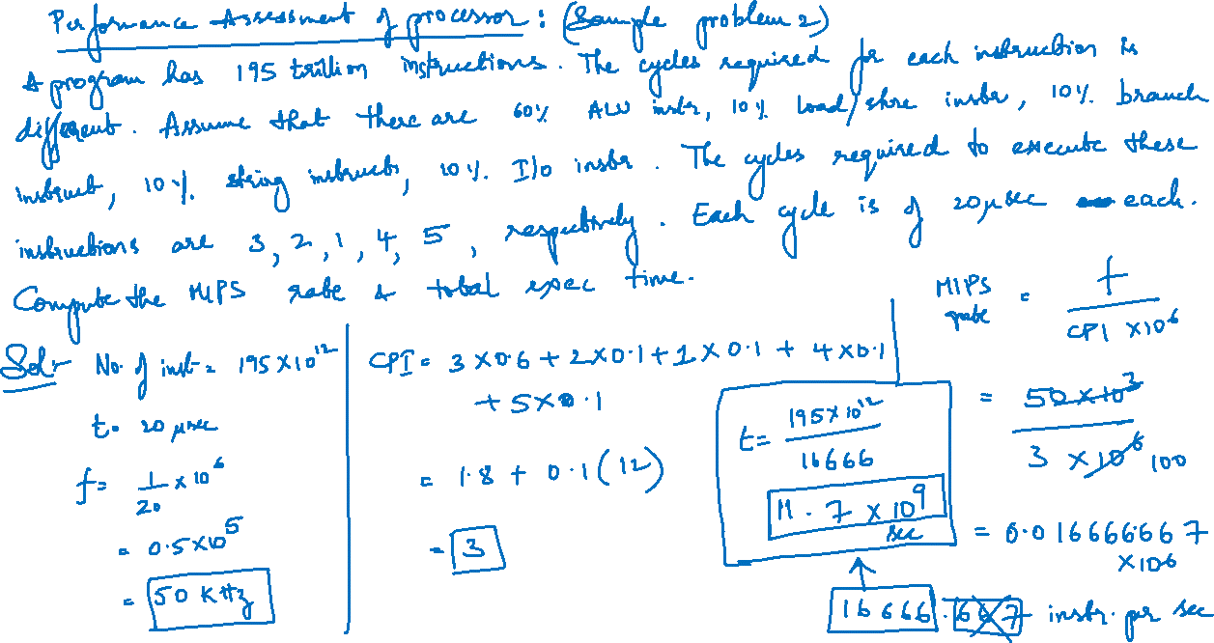

Slide 73
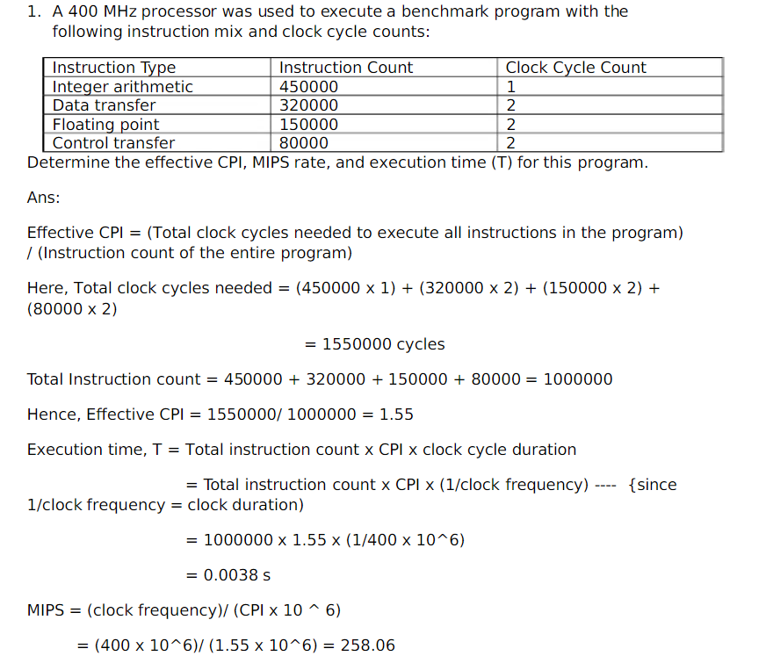

Slide 75
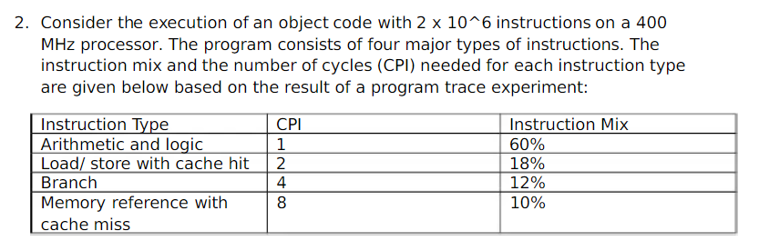
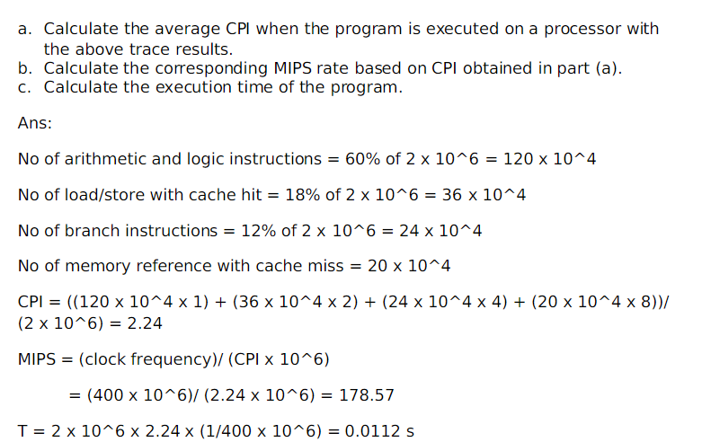

Slide 77
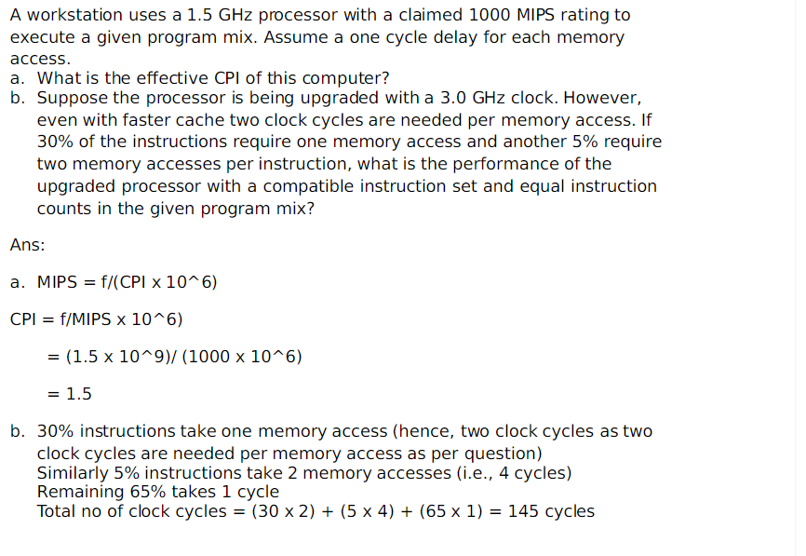
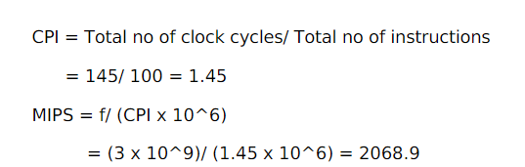

Slide 78
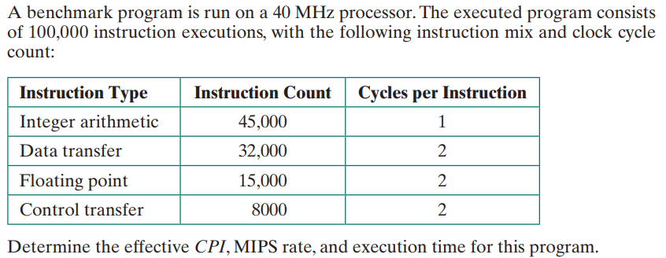

Slide 79
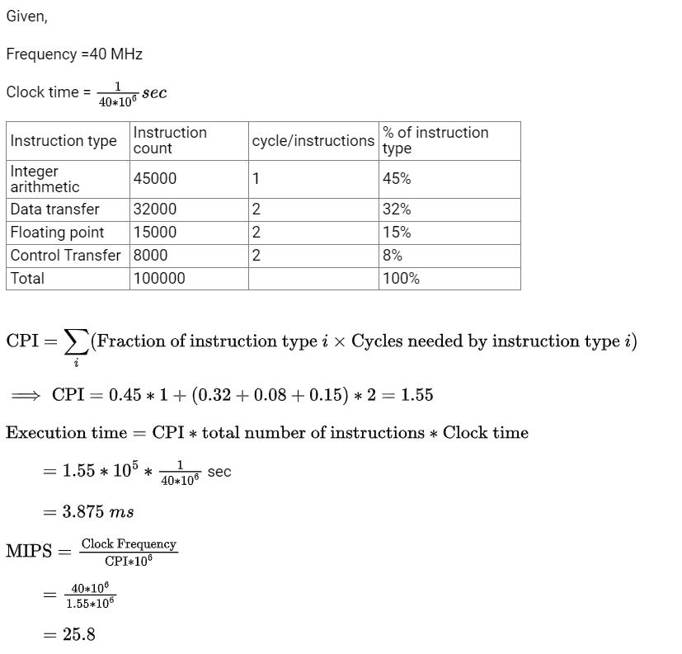

Slide 80
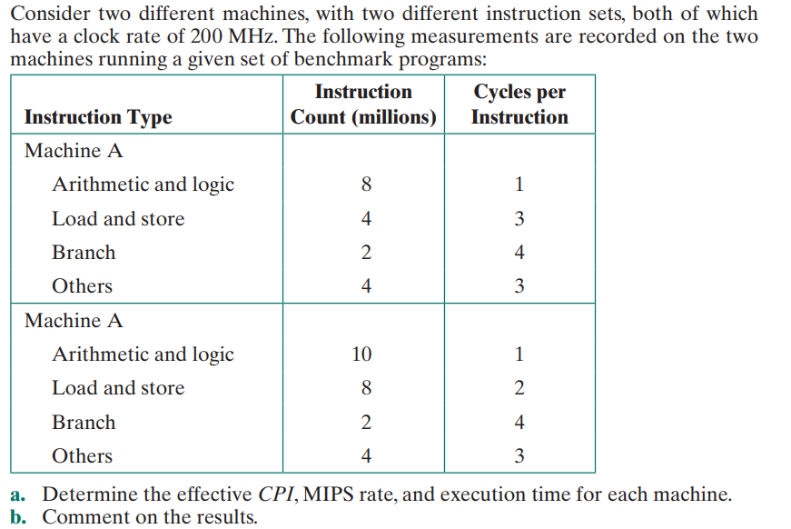
B

